Slide 1

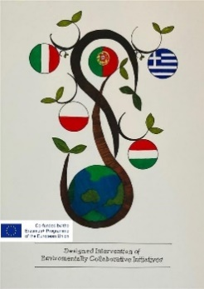

Erasmus plus KA229 2020 - 2023
DIECI: Designed Intervention of Environmentally Collaborative Initiatives
Greece- Hungary- Italy-Poland- Portugal
Rome 22 – 26 May 2023

Slide 2

Logo Creation
The first activity of the project was the Logo Creation
We students were split up into groups of two different nationalities
Each group designed a logo but didn’t complete it. The twinned partner had to complete it. The Polish and the Italian school won the final competition…..
…and the Project Logo was created

Slide 3
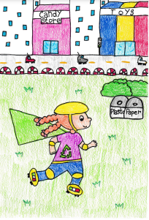
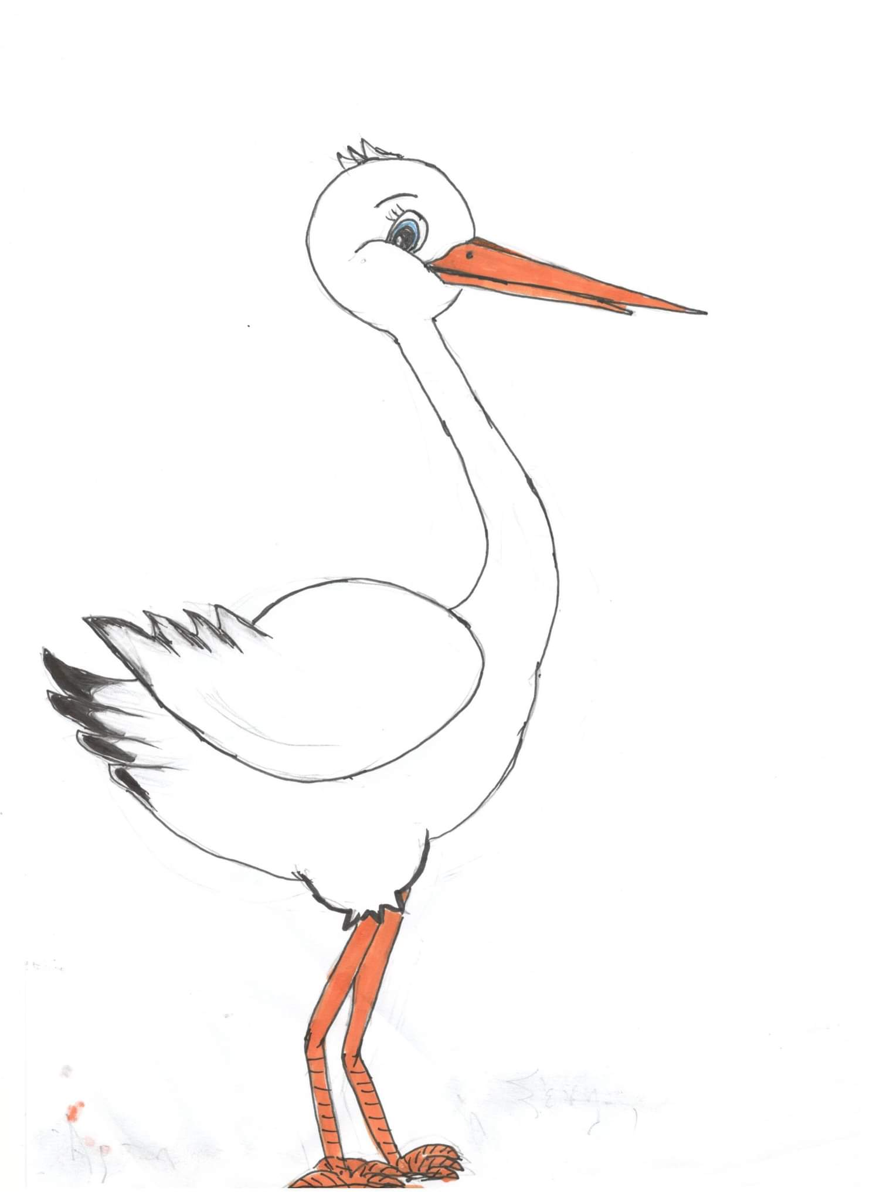
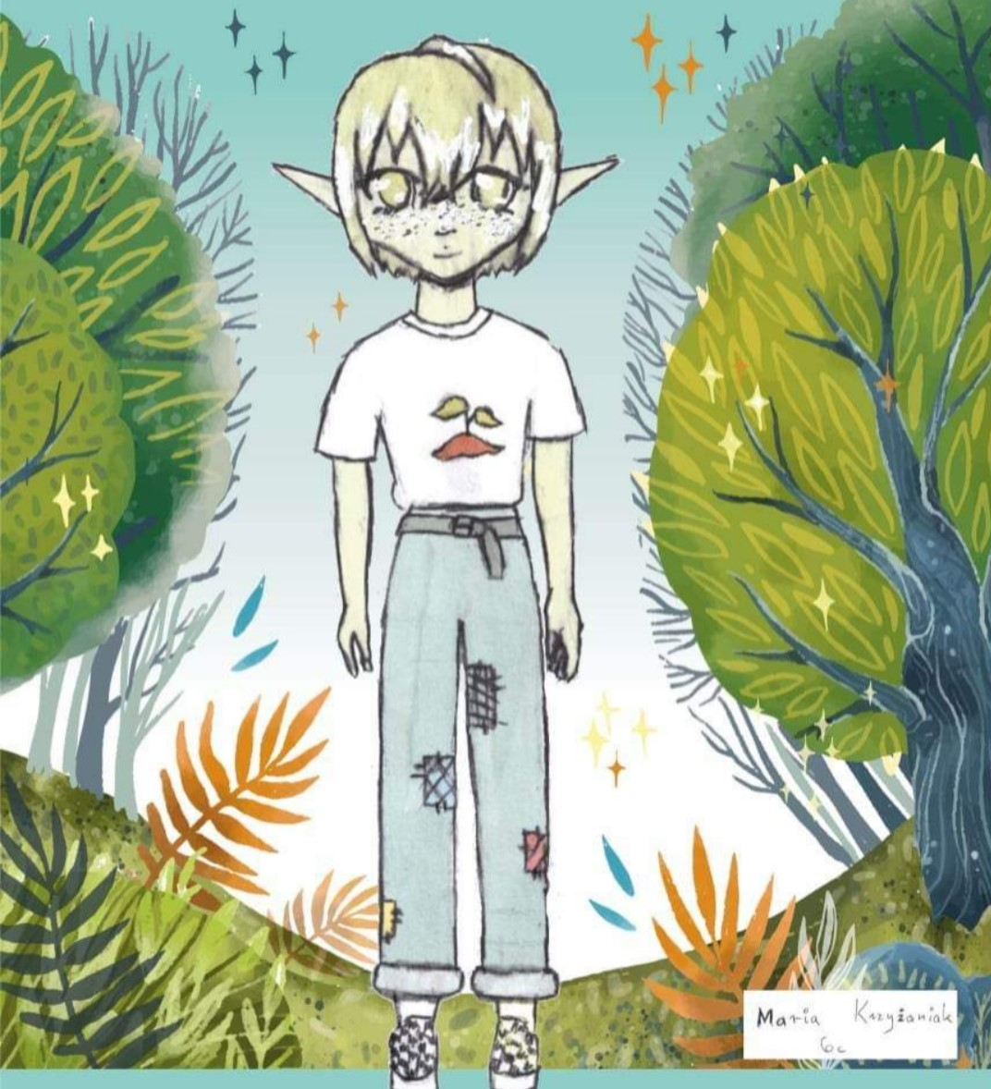
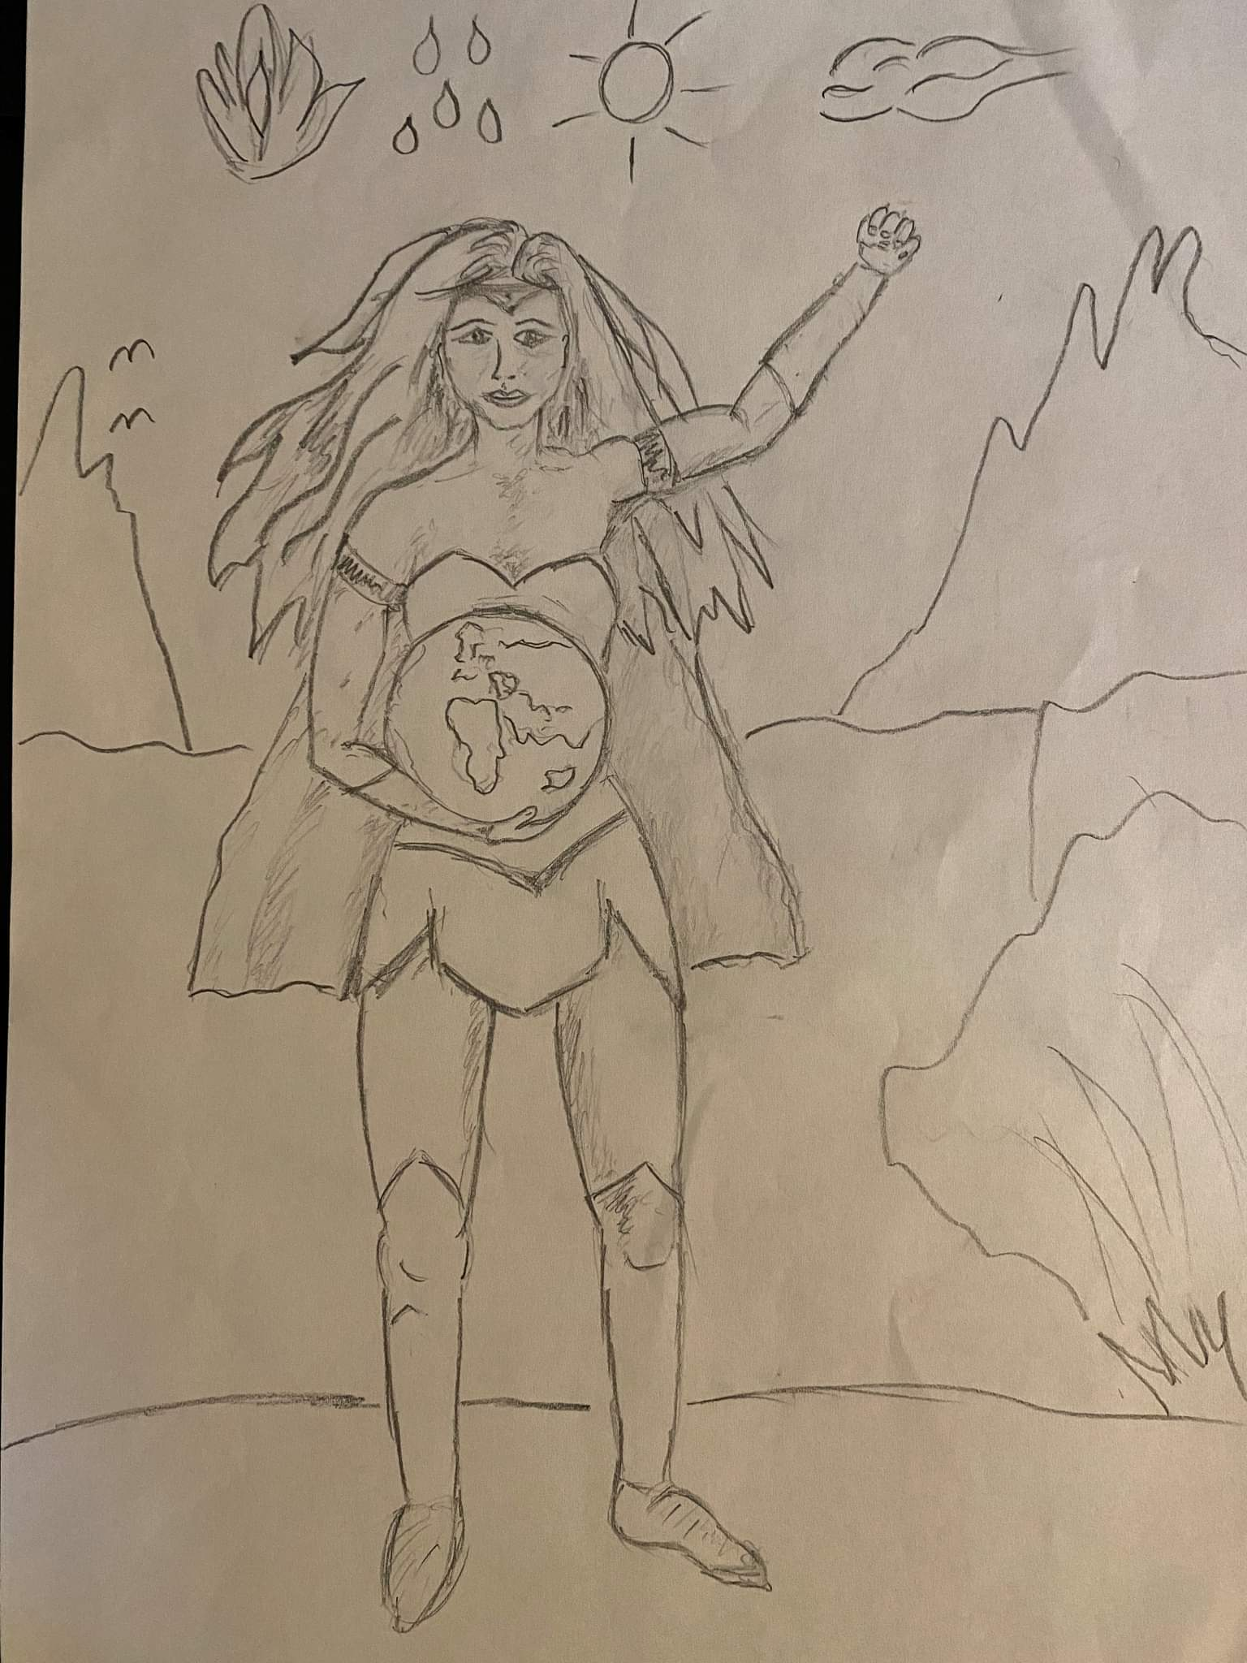
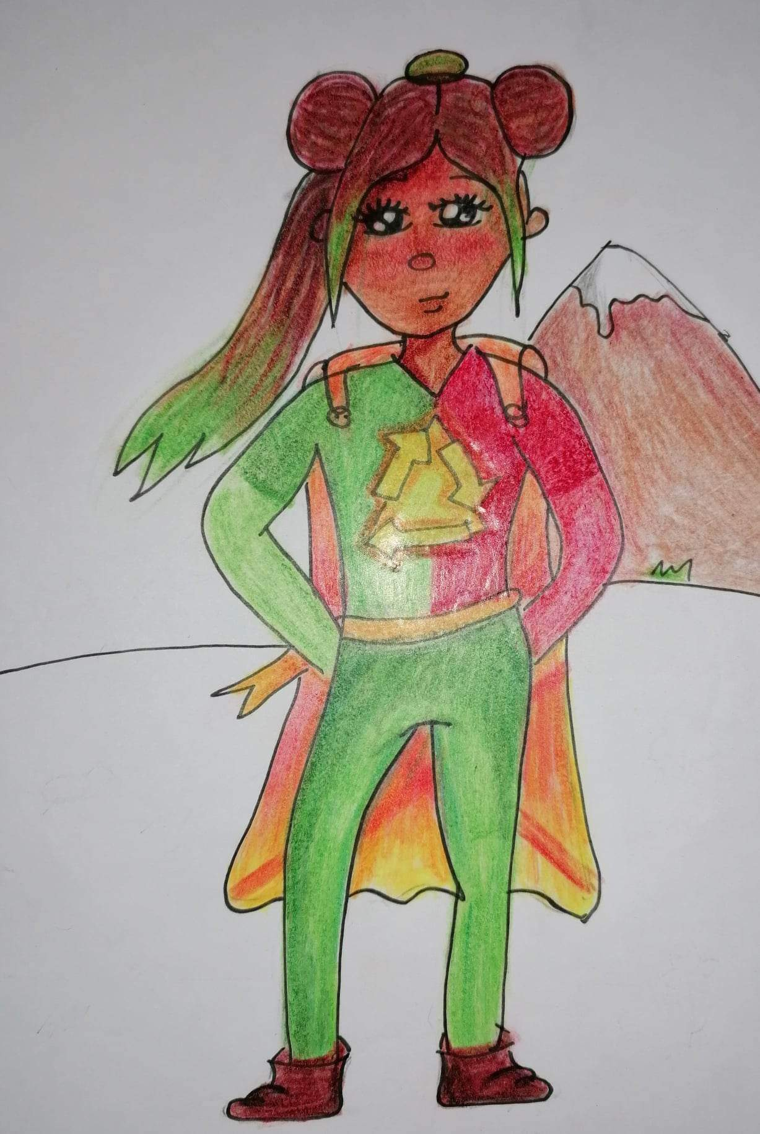
Our Eco Super Heroes
Each country created an Eco Super Hero: they protect the environment, their super power is
COOPERATION
Italy
Greece
Poland
Portugal
Hungary

Slide 4

How Green Are we?

Slide 5
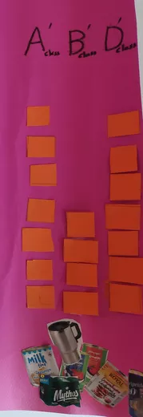
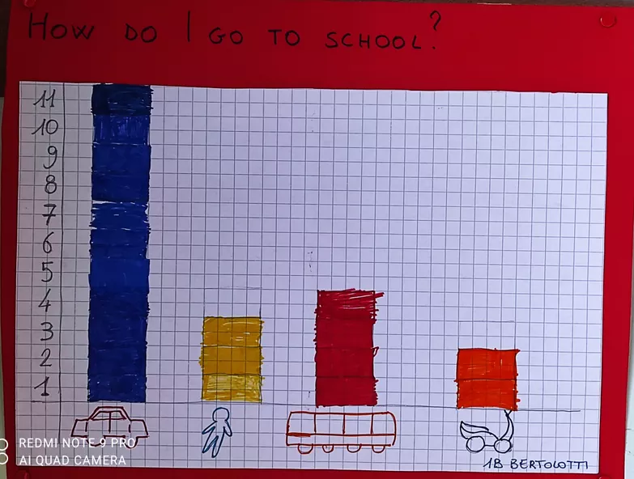
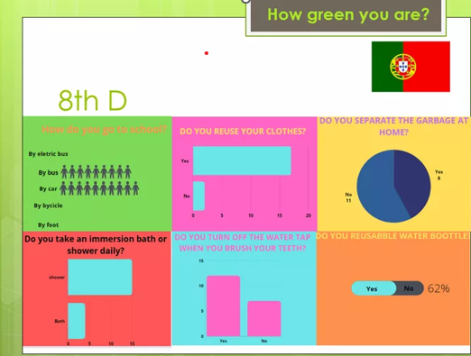
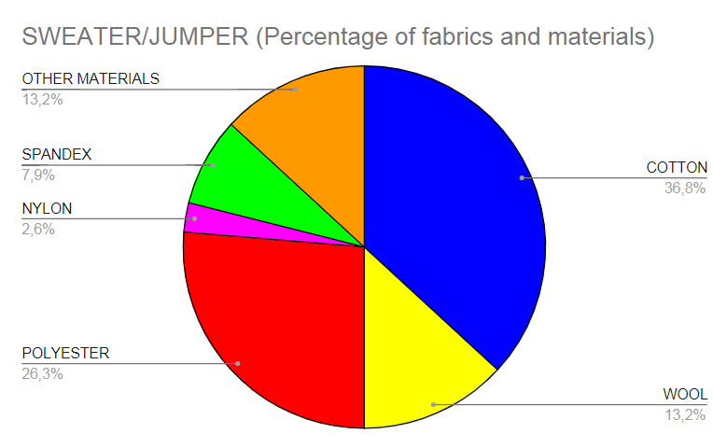
We carried out some researches about our daily habits and we created histograms……
The histograms were shared and compared on line among the partner schools…
….and the results were not encouraging

Slide 6

The results
We use too much transportation means
We don’t pay attention where our clothes come from
We use too many plastic items
We waste a lot of food
We produce too much CO2
We consume too much energy
We produce a lot of waste
But what’s CO2?

Slide 7
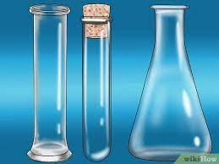
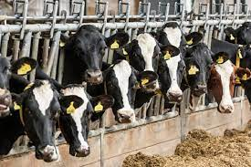
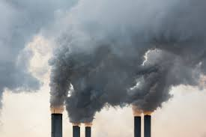
Scientists at work
With our teachers we made scientific experiments to understand what CO2 is and where it comes from…
Natural sources of carbon dioxide include most animals, which exhale carbon dioxide as a waste product
Human activities that lead to carbon dioxide emissions come primarily from energy production, including burning coal, oil, or natural gas
We uploaded the results of our experiments on a padlet…but this time we shared our experience in presence….

Slide 8
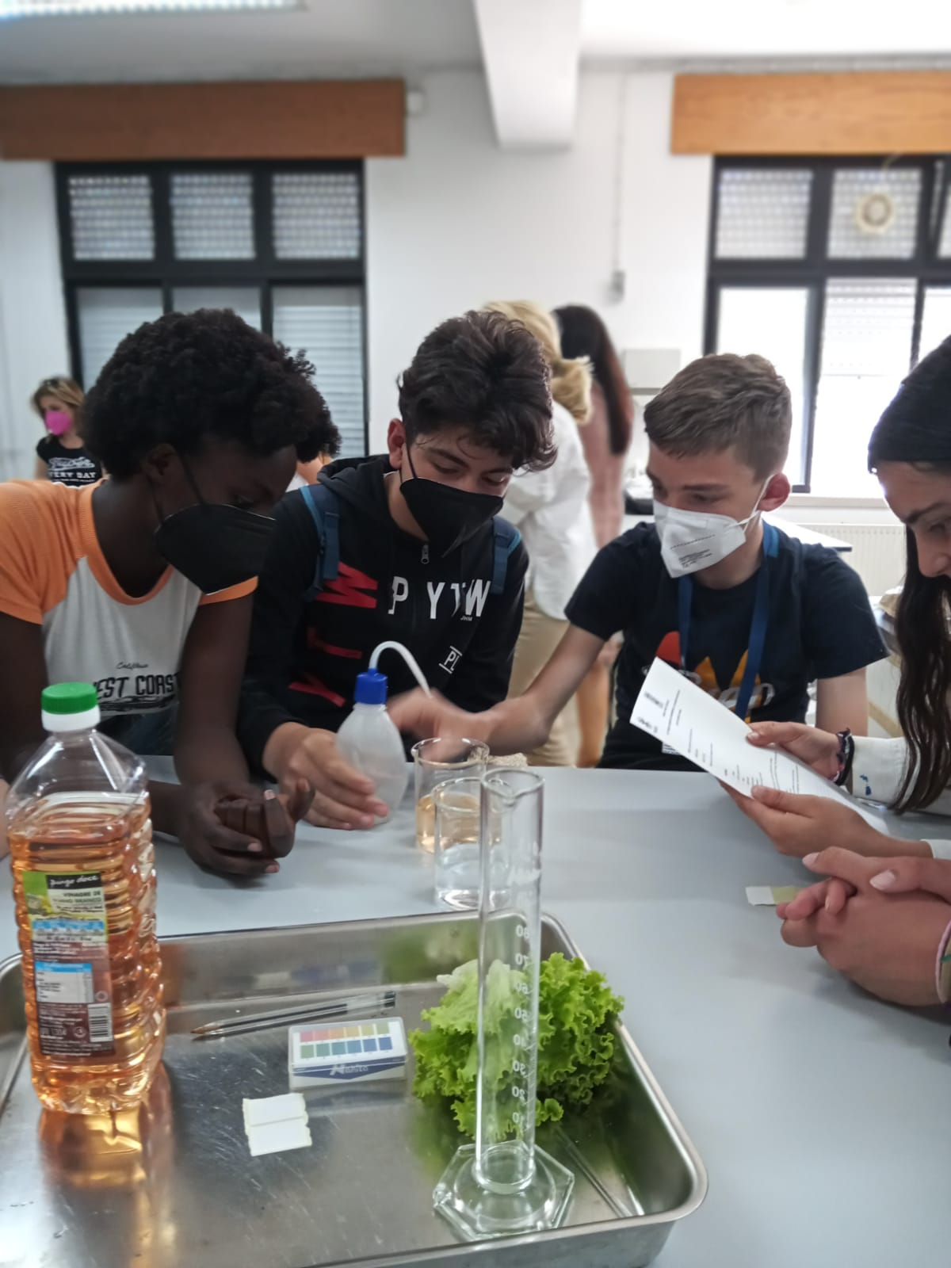
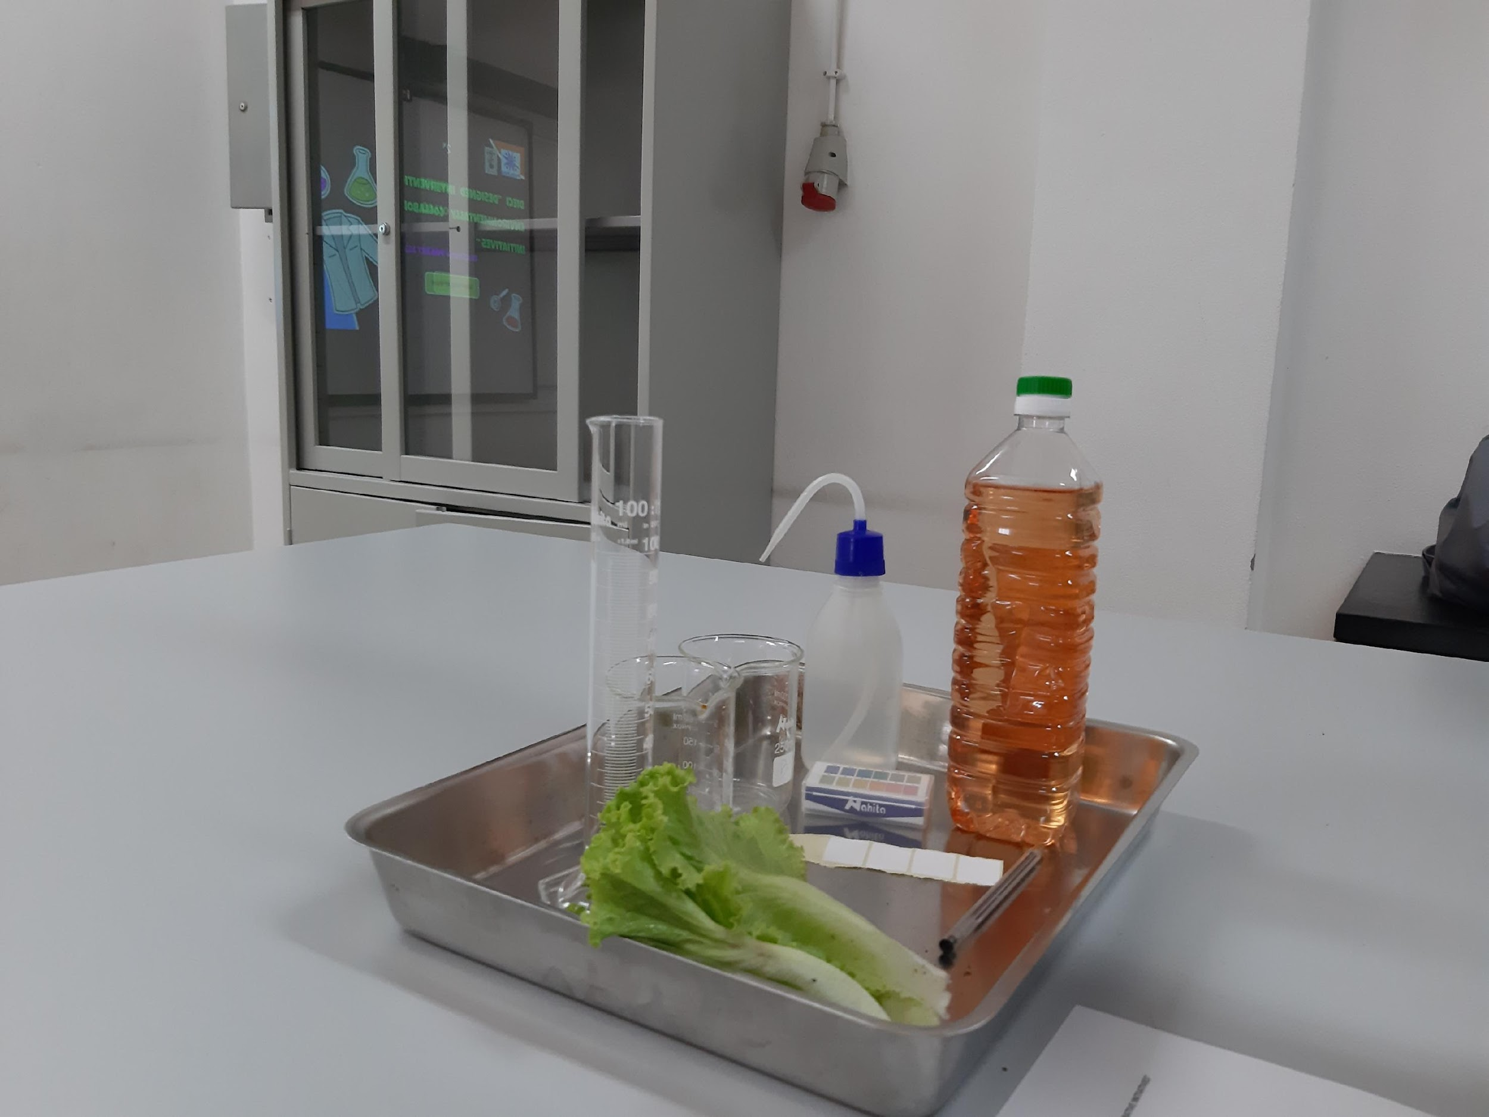
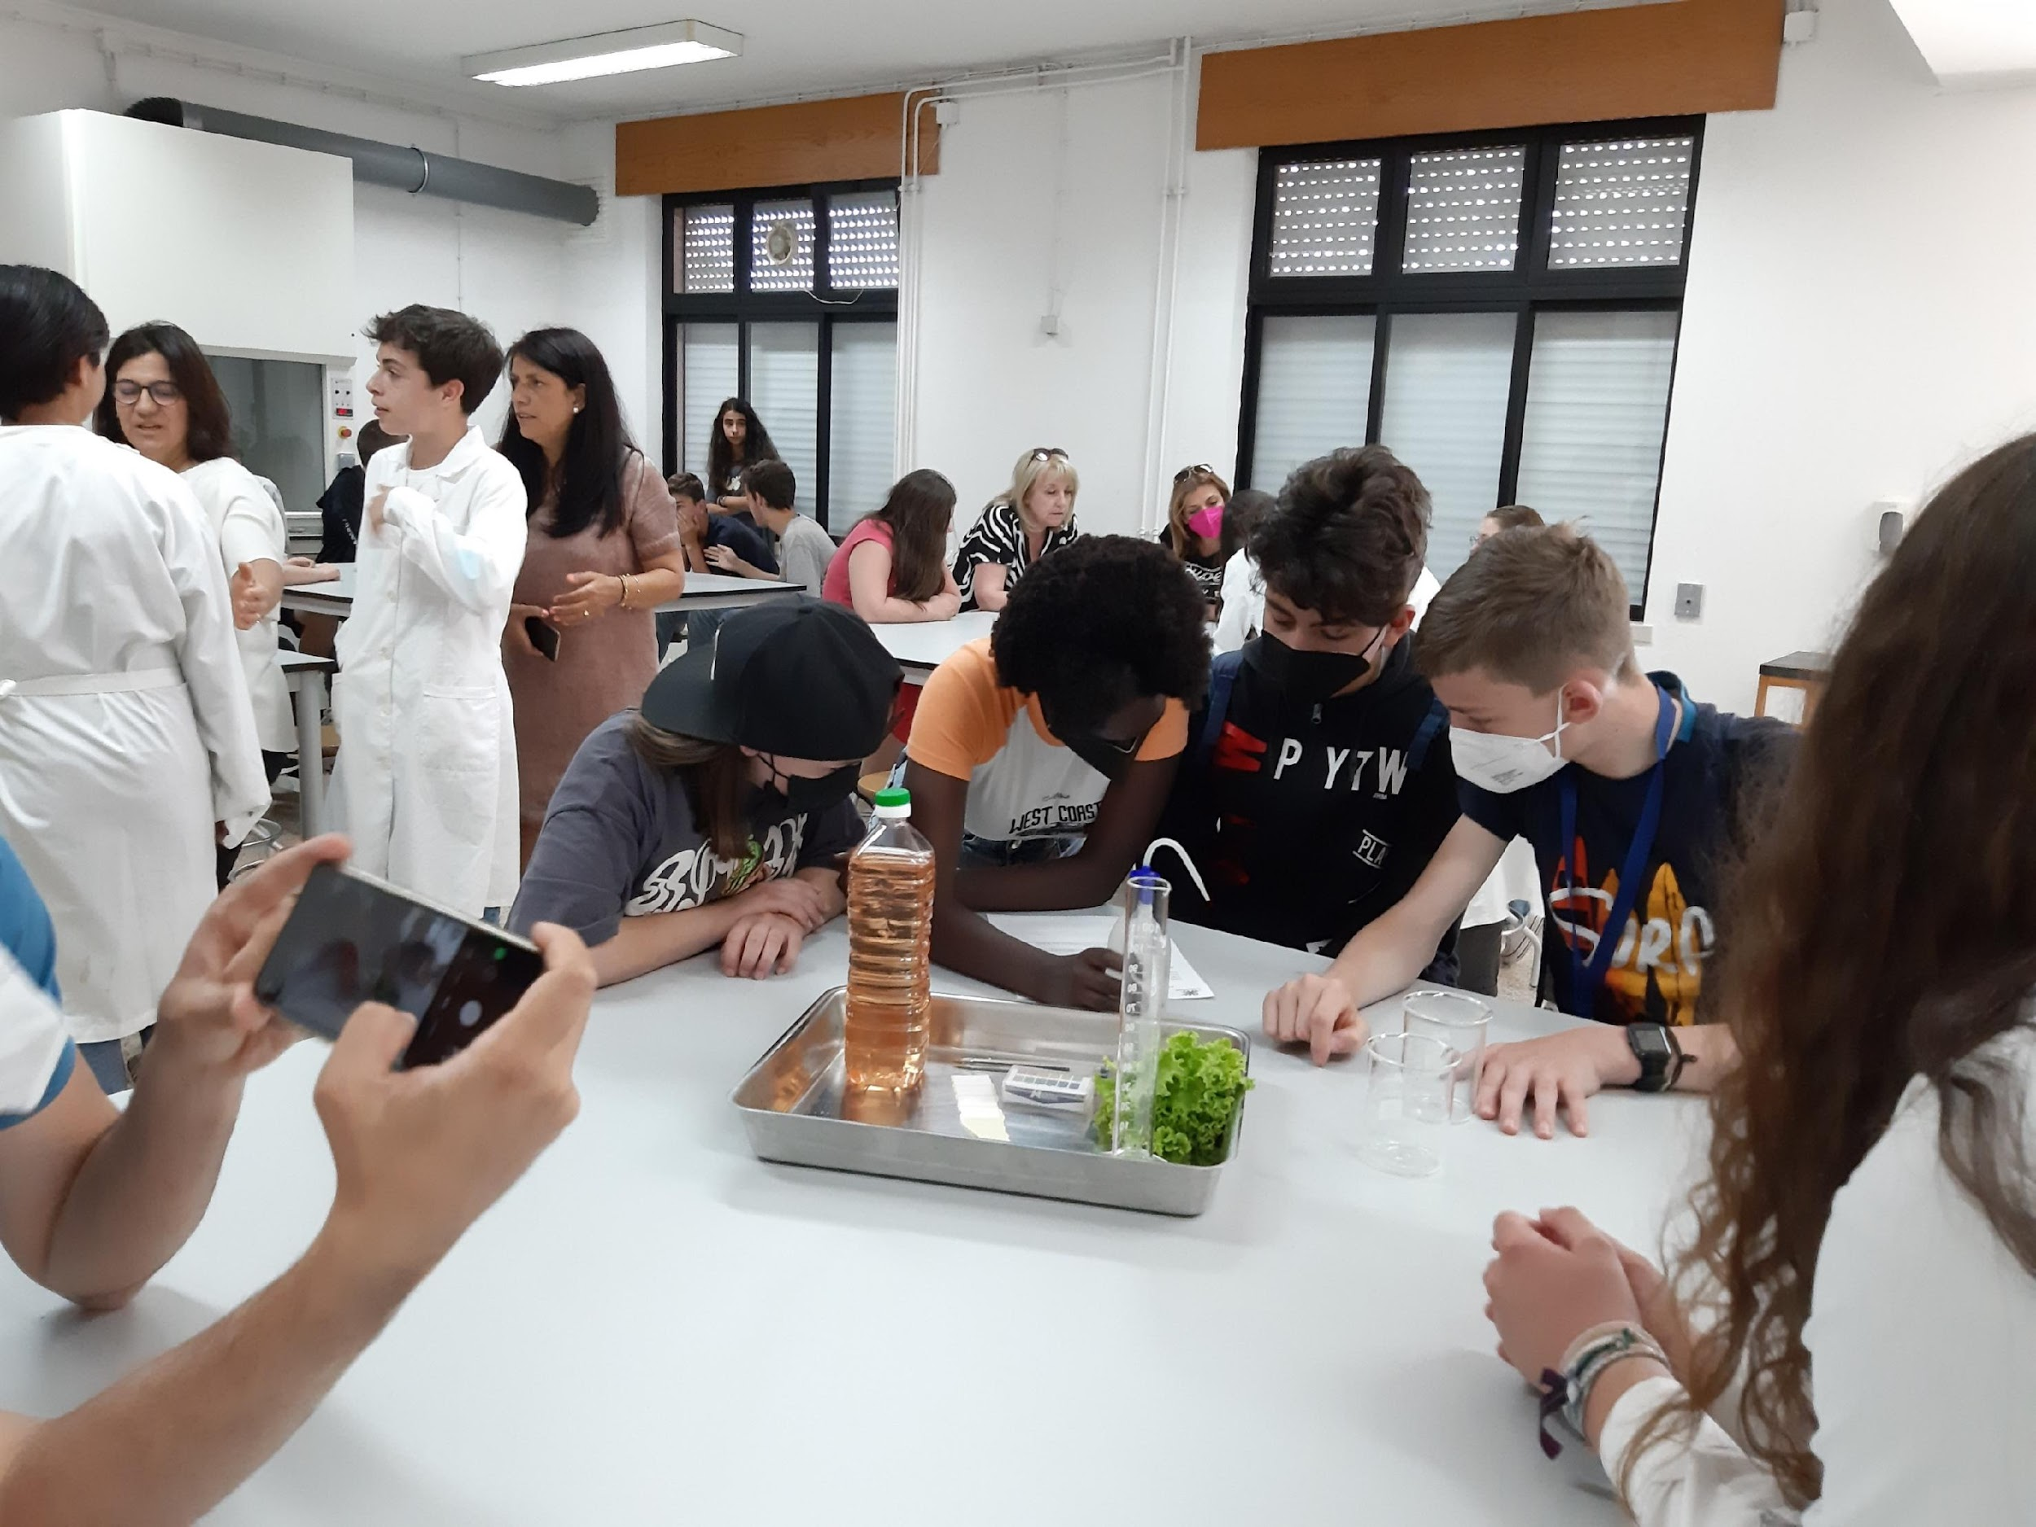
In Portugal……we finally could meet our partners!!!
We shared the results of the experiments
We conducted new experiments
It was very interesting..
Like real Scientists!!!

Slide 9

As you know….students are always so curious….so the next question was…
What does CO2 have to do with climate change?
CO2
Global Warming
Climate Change
How does climate change manifest itself?

Slide 10
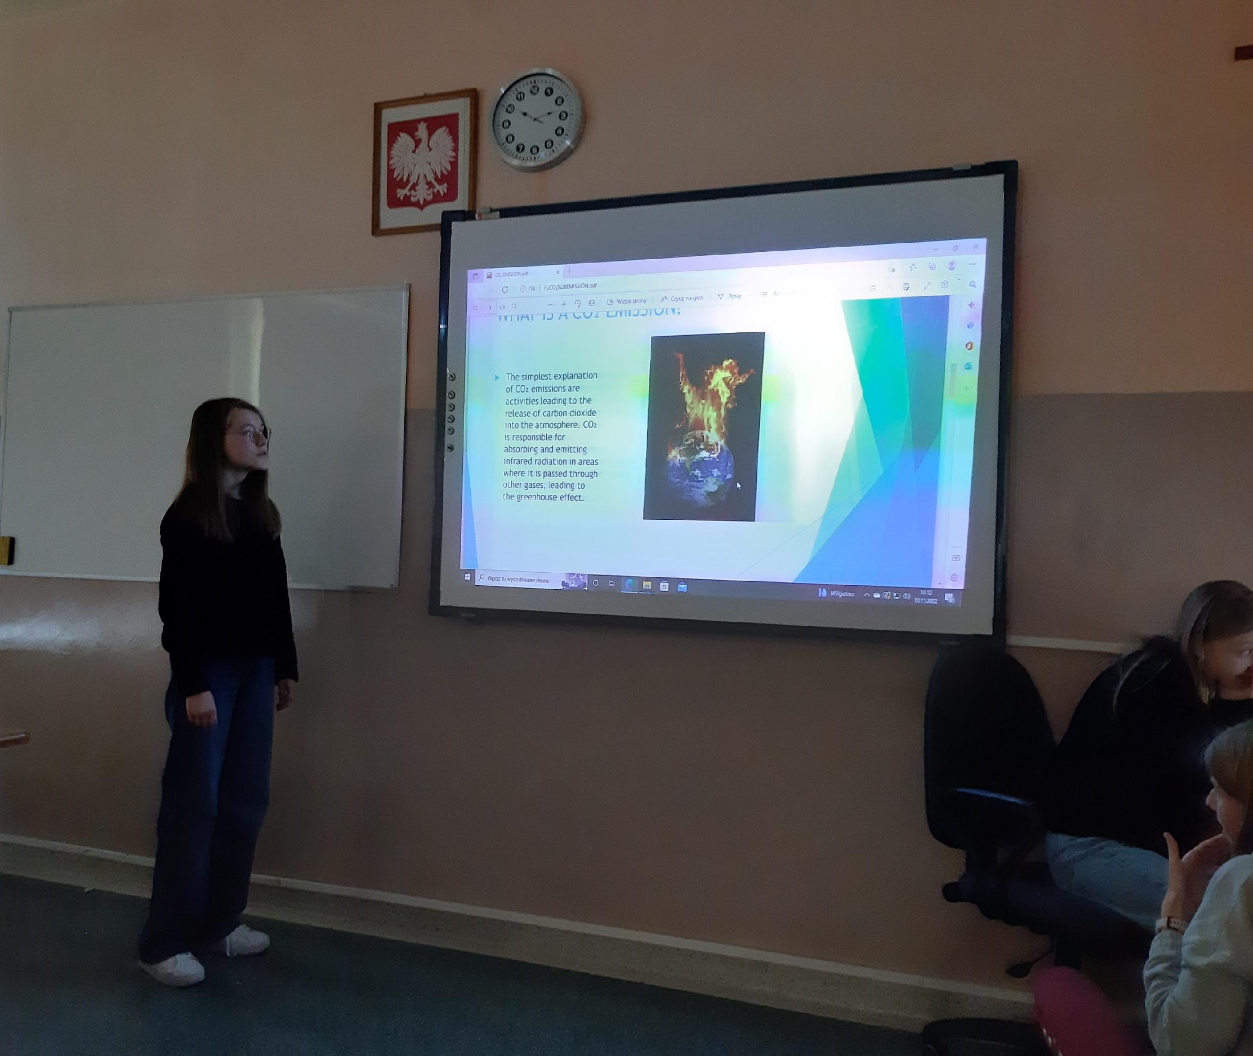
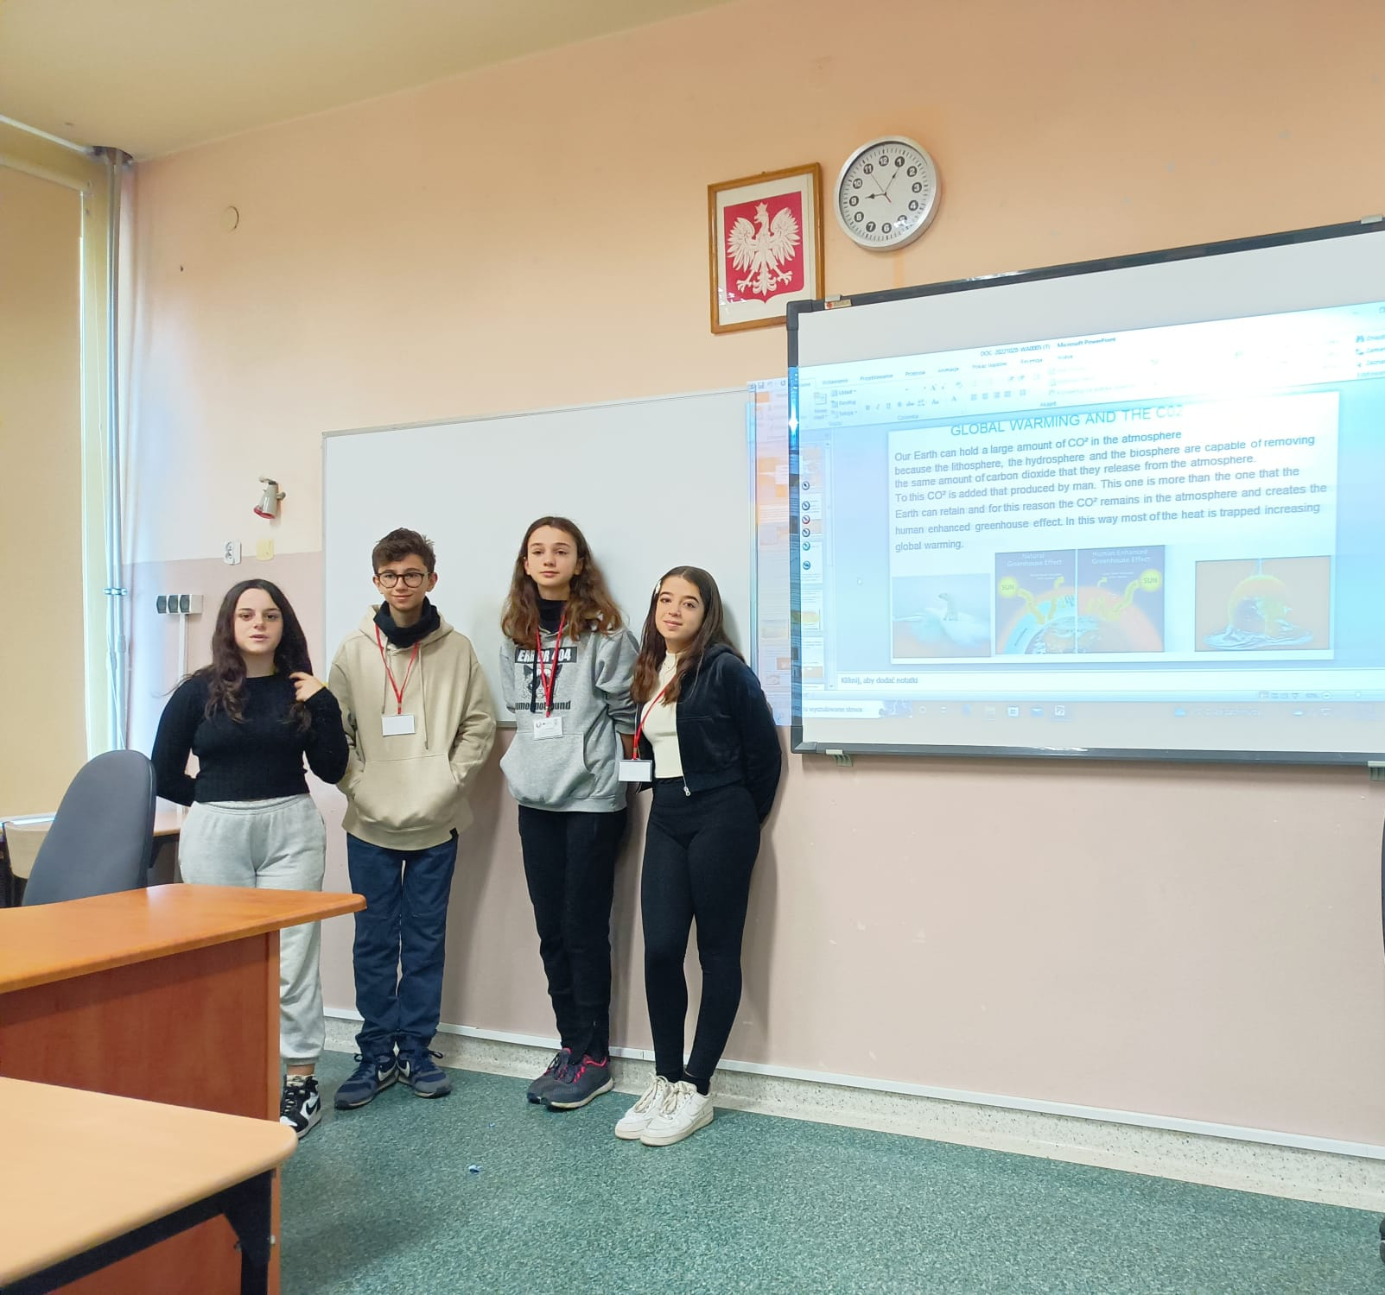
We carried out some researches about climate change effects
We prepared powerpoint presentations and we shared them with our partners in Poland
We learned that climate change is a GLOBAL EMERGENCY

Slide 11
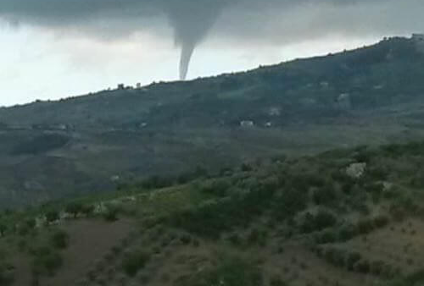
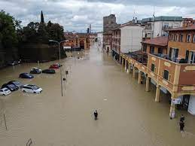
Tornado in Portugal
The effects of climate change are devastating
Floods in Italy

Slide 12
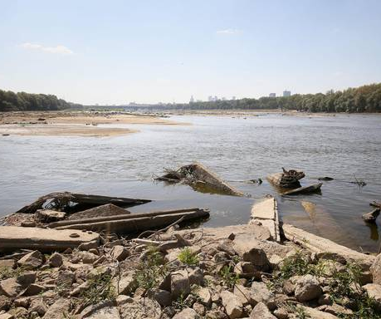
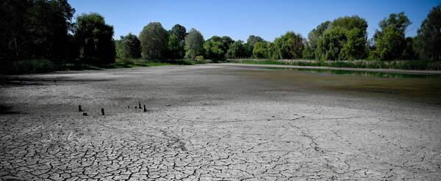
The drought in Poland and Hungary

Slide 13
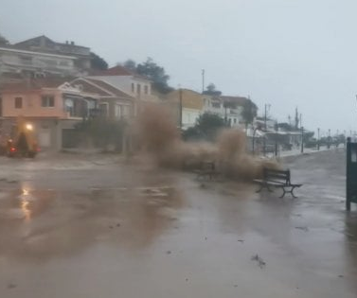
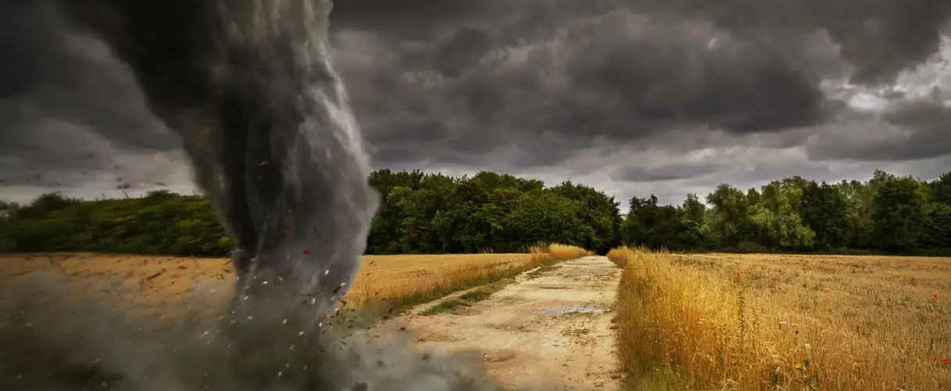
Hurricane in Greece
Cyclon in Italy

Slide 14
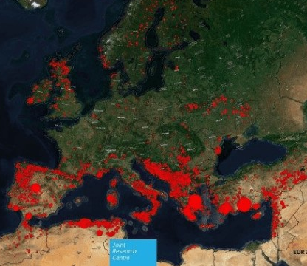
FIRES EVERYWHERE
And much more……….

Slide 15
We must do something!
We must stop this!
What can we do?
There are already so many associations, agencies, institutions that care for the environment….
DO YOU KNOW HOW MANY?

Slide 16
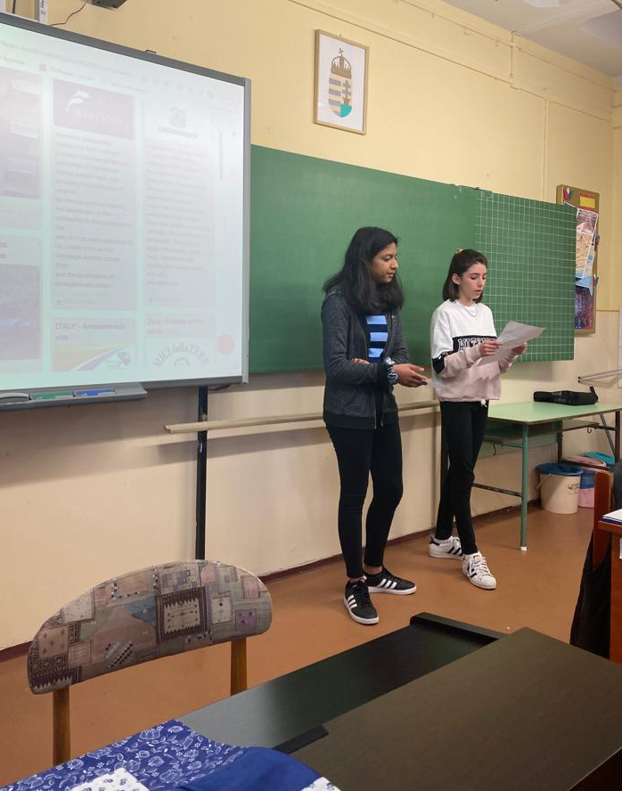
YOUNG ECOLOGISTS IN ACTION
We carried out some researches about the environmental associations, agencies, institutions that act in Europe and all over the world.
We published our results on a padlet and shared them with our partners in Hungary.

Slide 17


There are a lot of people committed to the environment protection…
…..so what can we do?
LET’S ACT
We must change our habits….IT’S TIME TO ACT
IT’S TIME TO CARE FOR OUR PLANET!
IT’S TIME TO CARE FOR OUR FUTURE!

Slide 18
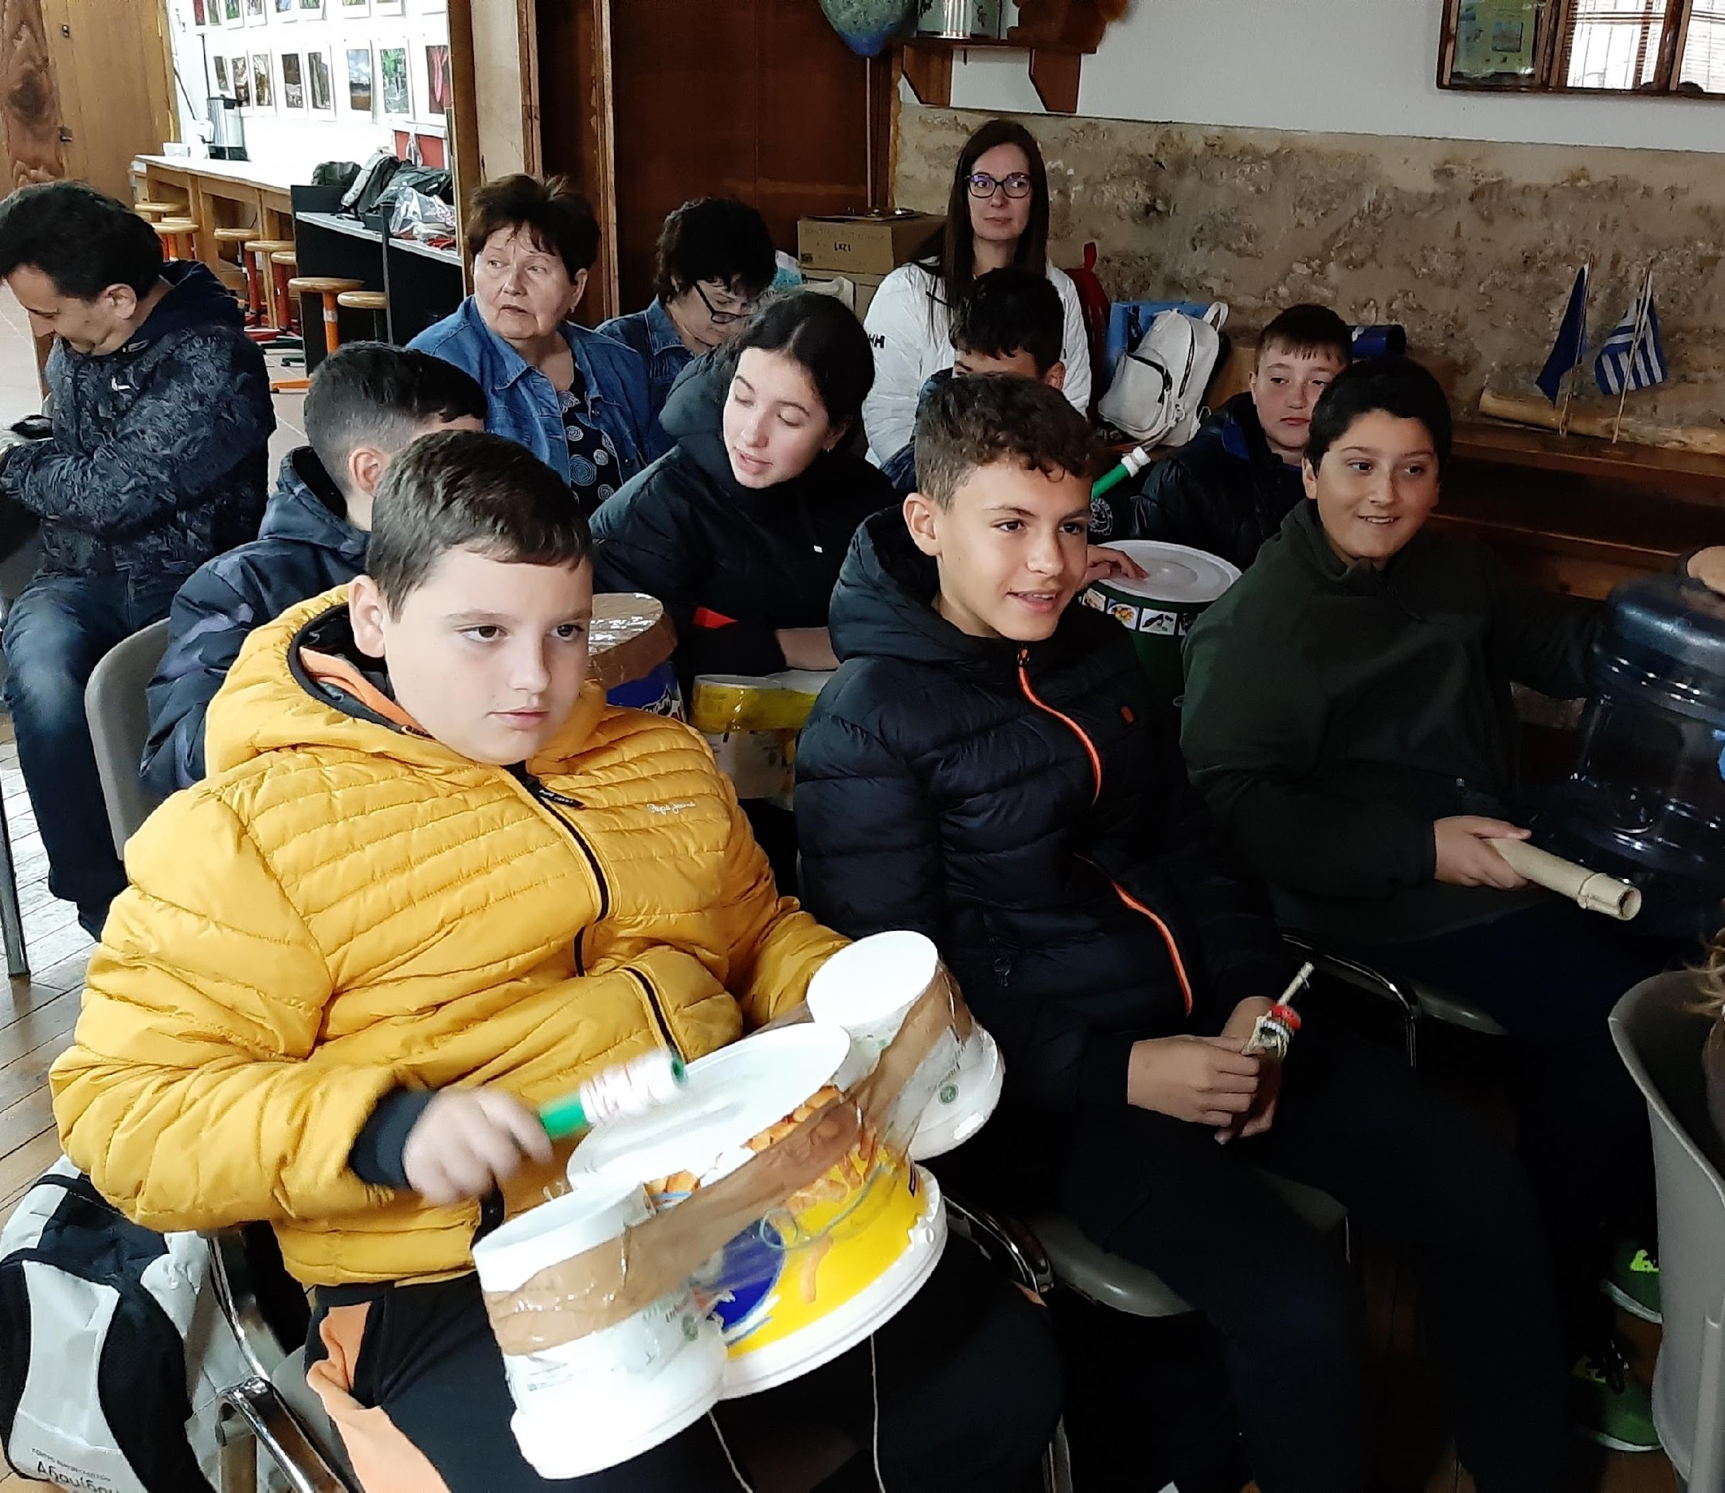
We reflected on the habits we need to change to improve our quality of life, save our planet and our future
We collected our ideas and created a handbook of green behaviors.
We shared it with our partners in Greece

Slide 19
And that’s what we learned………
The life of our planet depends on our actions
We must care!
We must cooperate!
We must collaborate!
WE MUST ACT!!!

